Slide 1


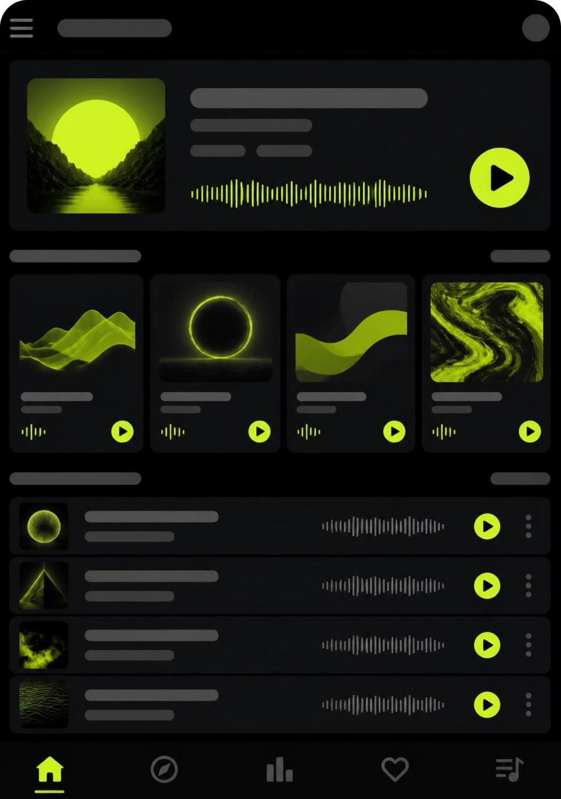
MUSIC FOR EVERYONE, EVERYWHERE
2008
Spotify – Changing the Way We Listen to Music
LAUNCH
Paplukács Levente · 2026.10.18

Slide 2





GLOBAL AUDIO PLATFORM
Spotify connects listeners with more than music
Global Reach
Three Audio Worlds
European Roots
Launched in 2008, Spotify now connects creators and fans across 184 markets worldwide.
A single home for music tracks, popular podcasts, and audiobooks where available.
Principal operational office in Stockholm, Sweden; registered corporate office in Luxembourg.
Sources: Spotify Newsroom & Annual Financial Filings (Form 20-F).

Slide 3



THE JOURNEY
From a Swedish start-up to a global platform
2006
Today
2008
Daniel Ek and Martin Lorentzon found Spotify.
Music sits beside podcasts and audiobooks on one platform.
Spotify launches its service.
2006 → TODAY
Source: Spotify corporate history and SEC Form 20-F disclosures.

Slide 4
THE FREEMIUM MODEL
Two ways to listen — one business model
Spotify Free
Spotify Premium
FINANCIAL RESULTS
€17.186B
AD-SUPPORTED
SUBSCRIPTION
Free access to millions of songs
Occasional sponsor advertisements
Shuffle mode on mobile devices
Ad-free uninterrupted listening
Offline downloads for travel
Unlimited skips and on-demand choice
Total revenue for the fiscal year ended December 31, 2025.
7,287
Average full-time employees in 2025 across all operations.
Gateway for new listeners
Main subscription driver
Official SEC Form 20-F filing.

Slide 5
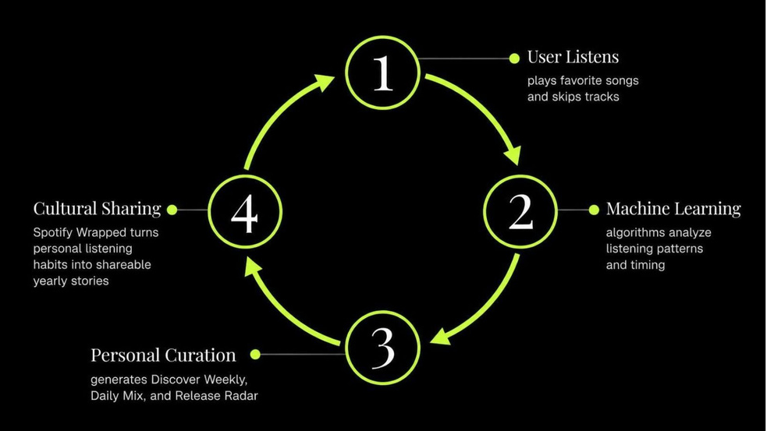
ALGORITHMS & DATA
Personalization is Spotify’s strongest habit
Smart recommendations transform millions of tracks into an individual listening journey.
100M+ Songs
7M+ Podcasts
700k+ Audiobooks
Vast catalogue of global music.
Stories, education, and talk shows.
Literary titles in key markets.

Slide 6


THE ROAD AHEAD
What comes next — smarter audio
Confirmed today: Spotify continues to unite music, podcasts, and audiobooks on one seamless platform.
Confirmed today: Discovery technology becomes more responsive to individual listening habits and daily routines.
Prediction: Future audio tools may become more interactive, social, and context-aware.
Discussion Questions
  When and where was Spotify founded?
  What is the difference between Spotify Free and Spotify Premium?
  Which Spotify feature do you find the most useful, and why?

